Slide 1

Medicine Faculty of Oporto University Biostathistic and Medical Informatics Department
INTRODUCTION TO MEDICINE – 1ST YEAR
CAMPOS P, FERREIRA D, GRADE C, MARTINS S, REINA S, SANTOS A, SANTOS J, SANTOS J, SERRA MJ, SILVA D, SILVA P
Class 19 – 2009/2010

Slide 2
Asthma Control in European Children
Significant and unacceptable differences among countries
SISTEMATIC REVIEW

Slide 3
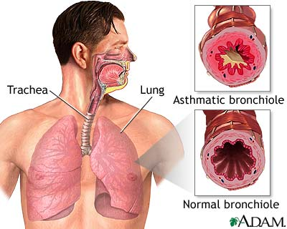
Introduction
Asthma is a chronic inflammatory disease of the airways with intermittent symptoms of wheezing, cough and breathlessness.^{[1]}
[2]
[1] Hammer SC, Robroeks CM, van Rij C, Heynens J, Droog R, Jöbsis Q, Hendriks HJ, Dompeling E. Actual asthma control in a paediatric outpatient clinic population: do patients perceive their actual level of control? Pediatr Allergy Immunol. 2008 Nov;19(7):626-33. Epub 2008 Jan 22.
[2] http://www.healthcentral.com/common/images/1/19375_6832_5.jpg

Slide 4

Introduction
[3]
Asthma guidelines exist in order to reduce the global burden of asthma. Although asthma guidelines may not be perfect, they appear to be the best vehicle available to assist primary care physicians and patients to receive the best possible care of asthma.^{[4]}
GINA (the Global Initiative for Asthma) has excellent guidelines for the prevention and management of asthma, intended for physicians and nurses. These guidelines are concerned with the treatment of asthma, and how to prevent attacks, as far as possible.^{[5]}
[3] http://medwebstudents2.files.wordpress.com/2007/11/portada-gina.jpg
[4] Bousquet, J. et all, GINA guidelines on asthma and beyond. Allergy 2007; 62(2):102-12
[5] http://www.healthandage.com/asthma-guidelines-from-gina

Slide 5
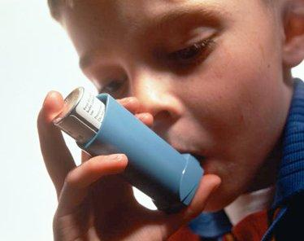
Introduction
Asthma control is defined by certain criteria, including:
presence of daytime symptoms twice or less a week;
no asthma symptoms or awakening at night;
minimal use of rescue bronchodilators is less than 4 puffs per week for rescue;
an ability to participate in normal activities and sports and normal pulmonary function tests;
no side effects to medication.
[6]
[6] http://topnews.in/healthcare/sites/default/files/asthma101.jpg

Slide 6
Introduction
For ongoing management of asthma, classification of asthma by level of control is relevant and useful:
Levels of Asthma Control
Characteristic | Controlled (All of the following) | Partly Controlled (Any measure present in any week) | Uncontrolled
Daytime Symptoms | None(twice or less/week) | More than twice/week | Three or more features of partly controlled asthma present in any week
Limitations of activities | None | Any
Nocturnal symptoms/awakening | None | Any
Need for reliever/rescue treatment | None (twice or less/week) | More than twice/week
Lung function (PEF or FEV₁)*** | Normal | <80% predicted or personal best (if known)
Exacerbations | None | One or more/year* | One in any week**
*Any exacerbation should prompt a review of the maintenance treatment to ensure that it is adequate.
**By definition, an exacerbation in any week makes that an uncontrolled asthma week.
***Lung function testing is not reliable for children 5 years and younger.

Slide 7
Introduction
“Using the Health Services Central Administration data base we reviewed 24271 admissions and saw that 48.7% of patients admitted were aged under 19 years-old”
“Asthma is a significant burden, not only in terms of health care costs but also of lost productivity and reduced participation in family life.”
Bugalho de Almeida A et al. Asthma hospital admission and mortality in mainland Portugal 2000-2007. Rev Port Pneumol. 2009;15(3):367-383
From the Global Strategy for Asthma Management and Prevention, Global Initiative for Asthma (GINA) 2008

Slide 8
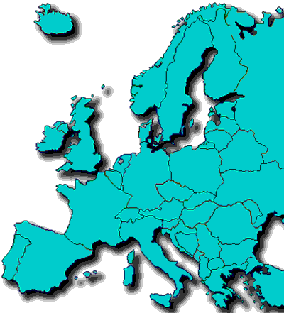
Research Question
What is the proportion of asthma control in children in Europe?
[7]
[7] http://www.enciclopedia.com.pt/images/europe-mapesf.gif

Slide 9

Aims
[8]
Study the proportion of asthma control in European children;
Account for the differences between European countries.
[8] http://www.ecorede.pt/fotos/editor2/missao_objectivos_ecorede.jpg

Slide 10
Methods
Study Design:
Systematic Review
Participants:
Observational studies on children (below or at the age of 18 years old) resident in Europe, who have asthma.

Slide 11

Methods Data Search
Three Stages
Key Words;
Effective Query;
Database Research.
[9]
[9] http://files.nireblog.com/blogs/mecanico1/files/computador.jpg

Slide 12

Key Words
Asthma;
Children;
Europe;
Control;
[10]
[10] http://virtuando.info/wp-content/uploads/2009/11/keyword-analysis.jpg

Slide 13
Effective Query
(Asthma[Mesh] OR asthma[tiab]) AND (child [MeSH] OR child [tiab]) AND (control))
TITLE-ABS-KEY(asthma) AND TITLE-ABS-KEY(control) AND ABS(child)
Topic=(asthma) AND Topic=(control) AND Topic=(children)
[11]
[12]
[13]
[11] www.medicine.mcgill.ca/.../PubMed_logo.png
[12] www.nikhef.nl/.../Scopus_logo_findout.jpg
[13] libinfo.uark.edu/Libimages/eresources/isinew.jpg

Slide 14
DataBase Research
N=6034
Pubmed
N=4948
Scopus
N=3587
ISI Web of Knowledge
N=14569

Slide 15

Methods Data Selection
Articles were
reunited in a
reference manager
[EndNote] in order
to ease the
assembling and
drawing processes.
Duplicates were
removed while
sorting through the
titles.
Thus concluding a total of 6672 articles.

Slide 16
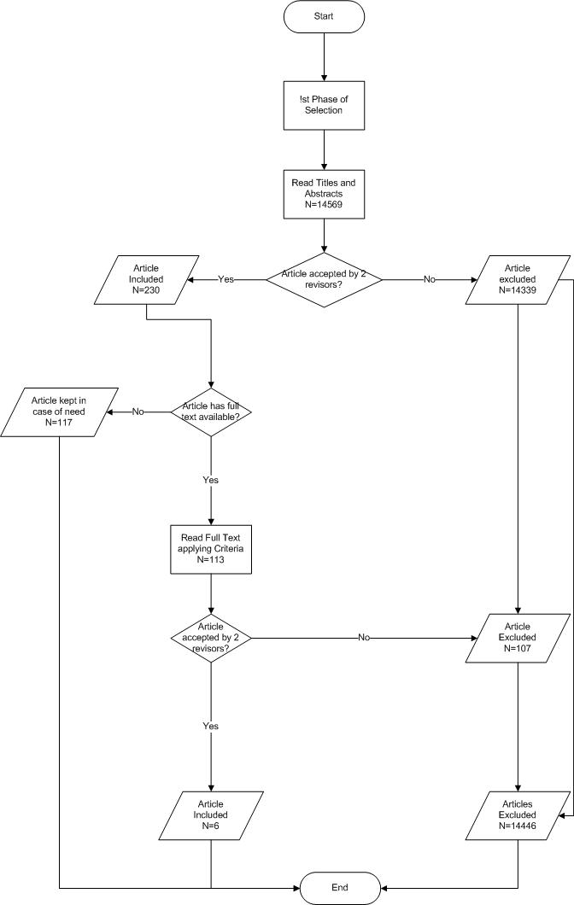
Methods Data Selection

Slide 17
Methods Data Selection
Inclusion Criteria: articles were included if…
The definition of control given in the article was according to GINA’s guidelines;
The study’s participants included children;
The country where the children were being controlled was an European one;

Slide 18
Methods Data Selection
Exclusion Criteria: articles were excluded if…
Only the methods of asthma control were focused;
The study’s result referred to both adults and children combined;
It did not measure the proportion of control;
The full text was not available*;
The text was not written in english.
*The articles which did not have their full text available were saved in an endnote file in case of unsatisfactory results. If that was the case, an e-mail was to be sent to the authors in order to obtain the full article.

Slide 19

Methods Quality Assessment
Performed independently by two reviewers, according to the STROBE checklist.
No articles were excluded on the basis of low-quality.
[14]
[14] http://www.ispm.ch/fileadmin/template_resources/strobe/logo-strobe.jpg

Slide 20
Methods Quality Assessment
The results of this parameter were:
None of the six articles had a score below 11 nor they had a maximum score.
One article included had a score of 13.
Three of the articles left had a score of 14, 15 and 16.
The maximum score obtained was 17, present in the two remaining articles.

Slide 21
Methods
Data Extraction
Ano | Autores | Type of study | Countries | Study Quality | Response rate | Title | % Controlled | % Partially Controlled | % Uncontrolled
2002 | C.E. Kuehni, U. Frey | cross-sectional postal survey | Germany-Switzerland | 15 | 85 | Age-related differences in perceived asthma control in childhood: guidelines and reality | 18 | 33 | 49
2006 | Williams, A.E., Lloyd, A.C., Watson, L., Rabe, K.F. | cross-sectional survey | Spain | 14 | --- | Women, patients with severe asthma, and patients attended by primary care physicians, are at higher risk of suffering from poorly controlled asthma | 15 | 31 | 54
2003 | Herjavecz I, Nagy GB, Gyurkovits K, Magyar P, Dobos K, Nagy L, Alemao E, Ben-Joseph R. | Cross-sectional study | Hungary | 17 | --- | Cost, morbidity, and control of asthma in Hungary: The Hunair Study. | 69 | 27,5 | 2,8

Slide 22
Methods
Data Extraction
Ano | Autores | Type of study | Countries | Study Quality | Response rate | Title | % Controlled | % Partially Controlled | % Uncontrolled
2008 | Cabanas Rodriguez ER, Gonzalez Barcala FJ, Cabanas Rodriguez P, Leis R, Martinez B, Cabanas R, Valdes Cuadrado L, Tojo R. | NS/NR | Spain | 13 | --- | Predictors of the persistence of childhood asthma | 69 | --- | 31
2006 | van Dellen QM, S. K., Bindels PJ, Ory FG, Bruil J, van Aalderen WM; PEACE Study Group | multi-centre cross sectional survey | The Netherlands | 16 | --- | Predictors of asthma control in children from different ethnic origins living in Amsterdam | 57,6 | --- | 42,4
2008 | Sanne C Hammer, Charlotte MHHT Robroeks, Christian van Rij, Jan Heynens, Richard Droog, Quirijn Jçbsis, Han JE Hendriks and Edward Dompeling | Cross-sectional studyCross-sectional study | The Netherlands | 13 | --- | Actual asthma control in a paediatric outpatient clinic population: Do patients perceive their actual level of control? | 8 | 37 | 55
For each study selected, a reviewer extracted data to an Excel© spreadsheet and another one confirmed the information. The information was afterwards compiled in an SPSS Syntax by a single student. The variables to be created were previously discussed and the syntax created by three reviewers working together.

Slide 23






Results
CONCLUSIONS
[15] http://thumbs.dreamstime.com/thumb_134/1175022048H3bmaj.jpg

Slide 24
Results The Netherlands
Van Dellen QM, S. K., Bindels PJ, Ory FG, Bruil J, van Aalderen WM; PEACE Study Group. (2007). "Predictors of asthma control in children from different ethnic origins living in Amsterdam." Respir Med. 101(4): 779-785.

Slide 25
Results The Netherlands
Hammer SC, R. C., van Rij C, Heynens J, Droog R, Jöbsis Q, Hendriks HJ, Dompeling E. (2008). "Actual asthma control in a paediatric outpatient clinic population: do patients perceive their actual level of control?" Pediatr Allergy Immunol. 19(7): 626-633.

Slide 26
Results Spain
Badiola C, B. L., Plaza V, Prieto L, Molina J, Villa JR, Cimas E. (2009). "Women, patients with severe asthma, and patients attended by primary care physicians, are at higher risk of suffering from poorly controlled asthma." Prim Care Respir J 18(4): 294-299.

Slide 27
Results Spain
Cabanas Rodriguez ER, G. B. F., Cabanas Rodriguez P, Leis R, Martinez B, Cabanas R, Valdes Cuadrado L, Tojo R. (2008). "Predictors of the persistence of childhood asthma." Allergol Immunopathol (Madr). 36(2): 66-71.

Slide 28
Results Germany and Switzerland
When stratified by age:
Excellent or satisfactory control:
66% of children aged 13–16 years
56% of children aged 10–12 years
44% of children aged 7–9 years
38% of children aged 4–6 years
Kuehni CE, F. U. (2002). "Age-related differences in perceived asthma control in childhood: guidelines and reality." Eur Respir J 20(4): 880-889.

Slide 29
Results Hungary
Herjavecz I, N. G., Gyurkovits K, Magyar P, Dobos K, Nagy L, Alemao E, Ben-Joseph R. (2003). "Cost, morbidity, and control of asthma in Hungary: The Hunair Study." J Asthma. 40(6): 673-681.

Slide 30

Conclusions
There is a difficulty in generalizing asthma proportion in European children, since the data collected are very few and different for each country found.
Asthma control can, at least, in one of the studies found,^{[17]} vary according with the age stratum, namely in Germany and Switzerland.
Ergo, it might be interesting to widen the spectrum of studies in this area, given the low number of relevant results.
[16]

Slide 31
Conclusions
[16]
Anyway, some explanations for poorly controlled asthma may be: - inadequate parents’ perception of asthma control ^{[17]} - the dynamic process of asthma ^{[18]} - too little step-up of asthma treatment by the paediatrician ^{[18]} - too little instruction on a proper inhaler technique ^{[18]}
[16] http://ted.coe.wayne.edu/sse/wq/Wichers/ImageFiles/conclusion.gif
[17] Kuehni CE, F. U. (2002). "Age-related differences in perceived asthma control in childhood: guidelines and reality." Eur Respir J 20(4): 880-889.
[18] Hammer SC, Robroeks CMHHT, van Rij C, Heynens J, Droog R, Jo¨ bsis Q, Hendriks JHE, Dompeling E. (2008). “Actual asthma control in a paediatric outpatient clinic population: Do patients perceive their actual level of control?" Pediatr Allergy Immunol 19: 626–633.

